Slide 1

2023-2024 IMI BIGDataAIHUB Case Competition
Team 33
Yan Pan Chung
Stef Scaini
Shuo Yang

Slide 2
Agenda
Task 1: Supervised Learning
Task 2: Unsupervised Learning GCN and Community detection
Task 3: Retrieval-Augmented Generation (RAG) and LLM

Slide 3
Task 1

Slide 4
Task 1: Supervised Learning
Methodology
Feature Engineering
Pre-processing and Normalization
Imbalance Investigation
Algorithmic Training and Evaluation

Slide 5
Process Data: Feature Engineering
KYC DataFrame
Binarized Gender (-1 'other')
One-hot encode Occupation
Cash DataFrame
Number of deposits by customer id
Number of withdrawals by customer id
$ Amount of all transactions
EMT DataFrame
Total wire amount sent by customer id
Total wire amount received by customer id
Wire DataFrame
Wire amount sent by customer id
Wire amount received by customer id

Slide 6
Process Data: Pre-processing
Outlier Detection
3-sigma outlier filtering
Train-Test Split
Train 75%
Val 15 %
Test 15%
Normalized Input Features
StandardScalar
Imbalance investigation
Non-target labels = 123719 (majority class)
Target labels = 3543 (minority class)
~34x imbalance

Slide 7
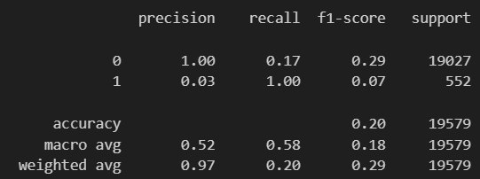
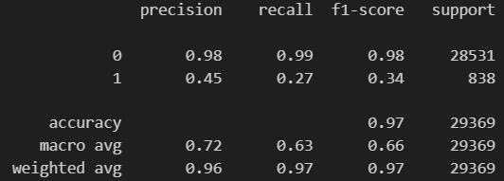
Training: Initial approach
Standard Upsampling / Downsampling
Random Forest, for interpretability and quick experimentation
Default parameters
Downsampling
F1 = 0.18
(high-recall)
Upsampling
F1 = 0.66
(high-precision)

Slide 8
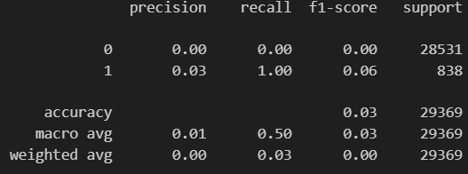
Training: Cluster-based resampling
Approach
Majority class is ~36x larger than minority class. We divided the majority class into 36 distinct agglomerative clusters. We paired each cluster with the entire minority class dataset and trained 36 random forest classifiers and ensembled in multi-voting scheme.
Performance
F1-score = 0.03 (
Worse performance that standard downsampling
Downsampling procedures lead to high recall models

Slide 9
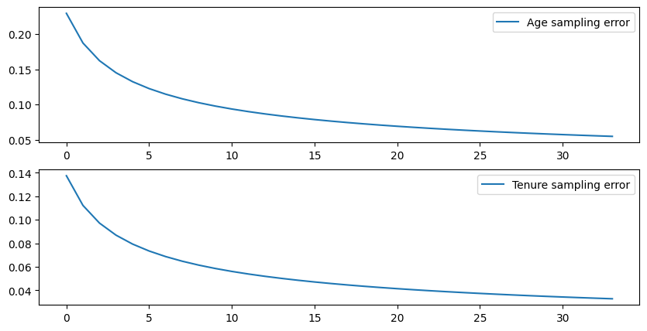
Training: Random up/down sampling
Approach
Upsampling seems to lead to high-precision models, while downsampling leads to high-recall models. Randomly up and downsample and ensemble models on random resamplings. How many models?
How many models?
When we randomly downsample, we lose information in the feature space distributions.
Must ensure that the number of random downsamplings approximates the majority class population parameters.
Perform 123719-choose-3543 n number of times until the resampling error (Z-score based SE) diminishes. We can perform this on two feature (Age, Tenure). When error is mostly reduced, this will give us 'n' models.
~30 models
Sampling Error
Sampling Error

Slide 10
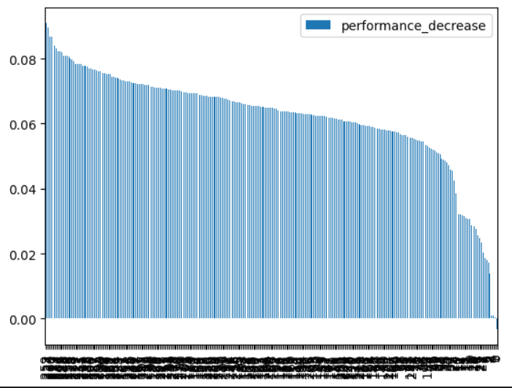
Training: Feature permutation importance
Approach
Method for selecting best predictor features
Randomly permute every feature one-by-one. Measure impact on performance
Use fully-connected NN for performance deterioration. Fixed random seed for reproducible comparisons
Base f1: 0.76
Permuted Feature Importance
Best Features
F1 Delta

Slide 11
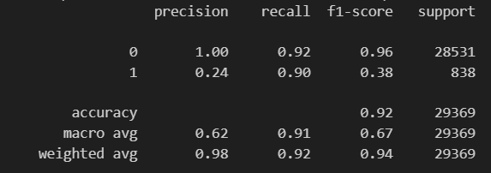
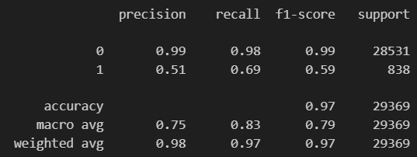
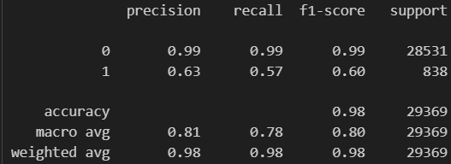
Evaluation: Random up/down sampling
Custom Models
Logistic Regression; Random Forest, MLP Classifier
Random up-and-down sampling
Performance
LR f1 = 0.67
RF f1 = 0.79
MLP f1 = 0.8

Slide 12
Evaluation: Random up/down sampling
Future Improvements
Hyperparameter Tuning
Further Feature Engineering
Outlier Detection algorithms

Slide 13
Task 2

Slide 14
Task 2: Unsupervised Learning GCN
Methodology
Build the Graph Dataframe
Build & Train Graph Convolutional Neural Network
Suspicious Pathways
Community Detection
Spectral Partitioning for Attribute Dissimilarity (with connectivity constraints)

Slide 15
Build Graph Data: Feature Engineering
Node DataFrame
Get master node (cust id) list from kyc, cash, emt, wire dataframes
External node (1,0)
Number of withrdawals (continuous) ; fill nill 0
Number of deposits (continuous) ; fill nill 0
$ Amount (conitinuous)
Gender (one-hot-encoded)
Age , fill null (median); less sensitive to outliers
Tenure, fill null (0); low impact
Occupation, one-hot-encoded; fill na unknown
Fraud/non-fraud one-hot-encode
Country, one-hot-encoded
Edge Attributes DataFrame
Message score
Cleaned messages
Sentiment analysis – not very useful for our problem
Similarity Analysis
Filter on nouns
Spacy language model
Key word bank
Sentence-keyword score
Wire amount
Domestic transaction
Foreign outbound transaction
Foreign inbound transaction
Unkown transaction

Slide 16
Build Graph Data: Graph labels and Mask
Approach
Considered both domestic and foreign labels (avoids overfitting to one 'type' of actor)
Robust statistical deduction & logical reasoning
27 positive masks | 11222 negative masks -- Expect GNN to predict 0.3% of nodes as traffickers
Positive Class Labelling​
Countries linked to IWT
High percentile filtering on wire amount (97th quantile)
Suspicious messages
High percentile cash-transfer amounts (97th quantile)
Collusion between domestic and foreign ids
Negative Class Labelling​
No countries excluded – to avoid FP based on country type
Median percentile filtering on wire amount
No suspicious messages
No suspicious occupations

Slide 17
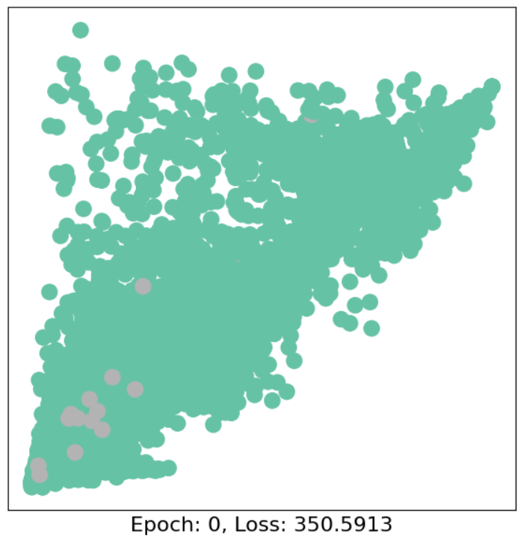
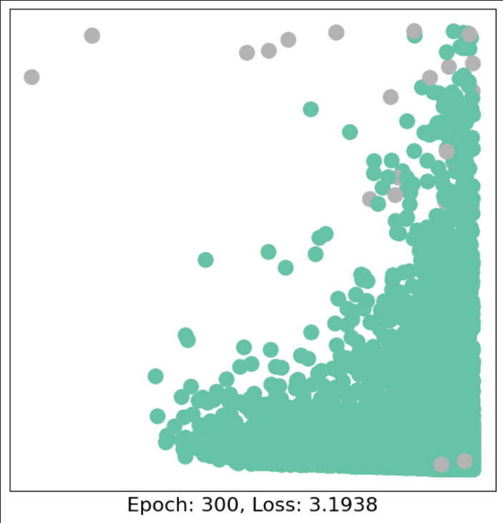
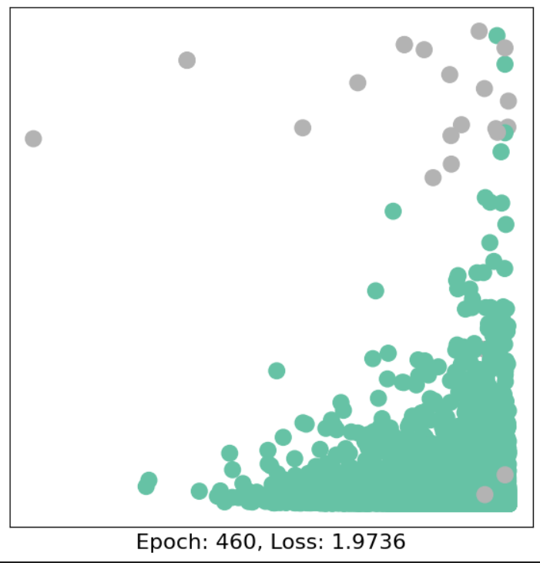
Graph Convolutional Neural Network: Training
Approach
Comprehensive approach that uses node features, edge connections and edge attributes to predict suspicious actors
Can leverage spatial information into prediction
The output the graph predictions will be an additional insight when assessing trafficking networks
Total Predicted Suspicious Actors: ~5400 1.8% of nodes
GCN
2 convolutions
Tanh activations
BCE Loss function
650 epochs
F1 score = 0.85
Embedding Space vs Epoch

Slide 18
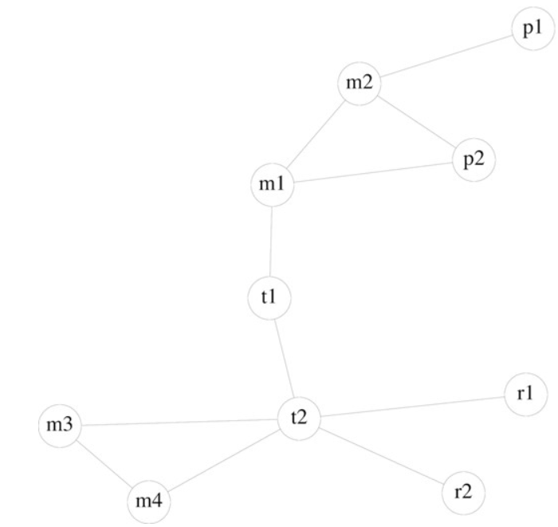
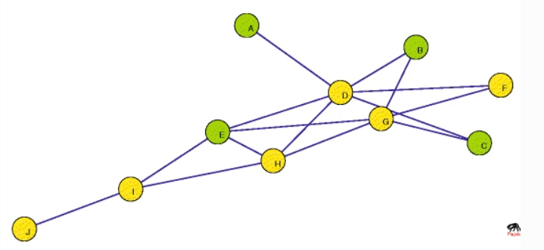
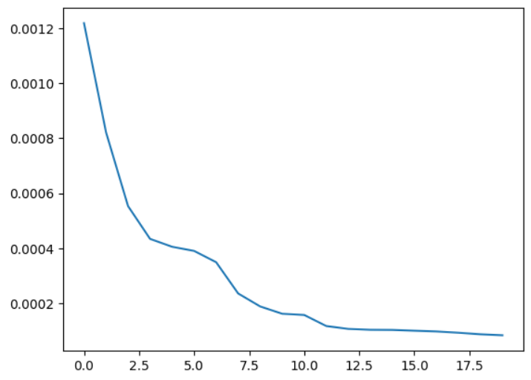
Suspicious Pathways: Cliques and Betweeness
Wild Life Syndicates
Approach
Total suspicious actors ~ 5400
Find suspicious actors that form a clique
Rank suspicious actors in cliques by 'betweeness'
5 suspicious actors
Adopting cybersecurity practice to reduce wildlife cybercrime
Federated databases and actionable intelligence: using social network analysis to disrupt transnational wildlife trafficking networks
Betweeness Centrality
'Criminal networks have key players identified through social network analytical metrics... the betweeness centrality measure indicates the intermediary with the most control over information. ' -- Timothy C Haas
Trafficker Nodes

Slide 19
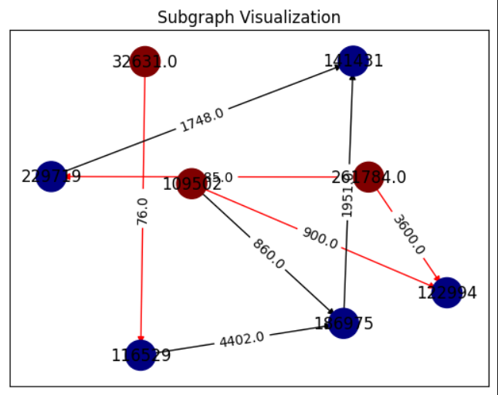
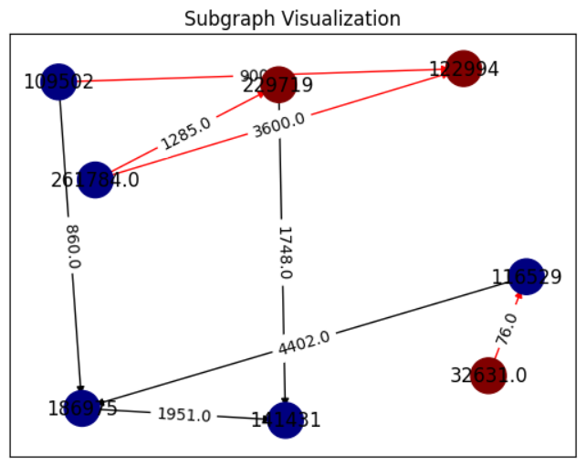
Suspicious Pathways: Results
Refining Paths
Shortest paths between suspicious nodes --> 20 paths
5 < path length < 15 --> 14 paths
Suspicious nodes > 3 -->2 paths
Shortest Path Algorithm
All the shortest paths are recorded for each (source, target)
These paths are combined to create a network that connected at least two suspicious nodes
Network Properties
7 unknown transaction destinations/countries (both networks)
1 domestic transaction (both networks)
2 known tenures ~ 10 years each (both networks)
Normal wire amounts & normal message scores

Slide 20
Community Detection: Modularity
Network Detection using Modularity
Measures the sturcture / substructures of a network directly
Modularity represents density of connections within a module/partition relative to other modules in the graph
Used for detecting 'Community Structure' i.e. a network—expect IWT networks to conform to community structure
Problems
Computationally expensive
Resolution Limit: may fail to find smaller communities within larger ones
Most of the graph is unrelated to animal trafficking – noisy partitioning

Slide 21
Community Detection: Neighbourhood subgraph
Approach
Positive GNN training labels used to create a subset of the graph
5-level neighbourhood around all positively labelled actors
5-level neighbourhood is extensive enough to capture large portion of graph, while eliminating regions that are not related to IWT
Total Graph Reduction: 166311 nodes ( 44%) | 382256 edges (33%) | node degree == 2.3 (20%)
Solution
Reduces computational complexity
Resolution Limit: lowered resolution across entire considered graph
Reduction in overlapping communities, and large hierarchical structures (helpful for convergence)

Slide 22
Community Detection: Iterative Louvain Modularity & Results
Results
Louvain modularity maximization until desired community resolution --> 19 networks
Message scores > 0.2 -- > 12 networks
High wire amounts > average wire amount --> 11 networks
Countries | Max Wire | Max Msg Score | # domestic trxs | # foreign outbound trxs | # foreign inbound trxs | # unknown trxs | Ages | Tenures
IN, CA | ~1k | 0.3 | 1 | 0 | 0 | 6 | 40, 34, 32, 19, 37 | 2, 12, 11, 8, 0
AU, CA, MX | ~45k | 0.53 | 2 | 0 | 0 | 6 | 36, 25, 22, 35, 50 | 4, 0, 0, 6, 1
CA, MX, US | ~44k | 0 | 2 | 2 | 3 | 8 | 23, 20, 30, 38, 24, 38, 28, 37 | 5, 2, 0, 7, 6, 4, 0, 0
CA, IN, GE | ~45k | 0 | 2 | 1 | 1 | 19 | 22, 36, 30, 38, 24, 34, 44, 57,… | 4, 2, 7, 6, 3, 6, 9, 12, ...

Slide 23
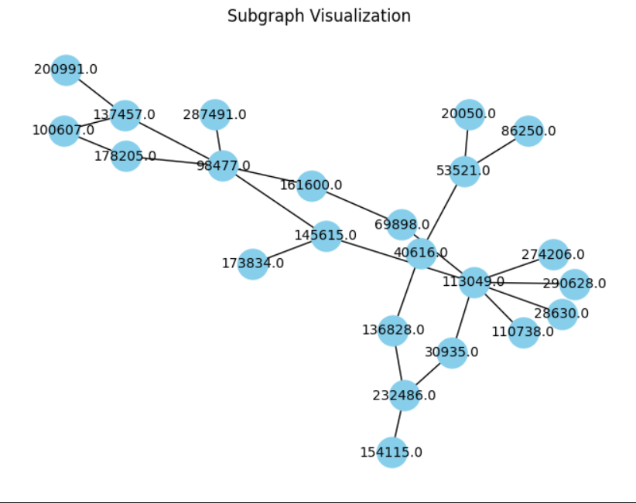
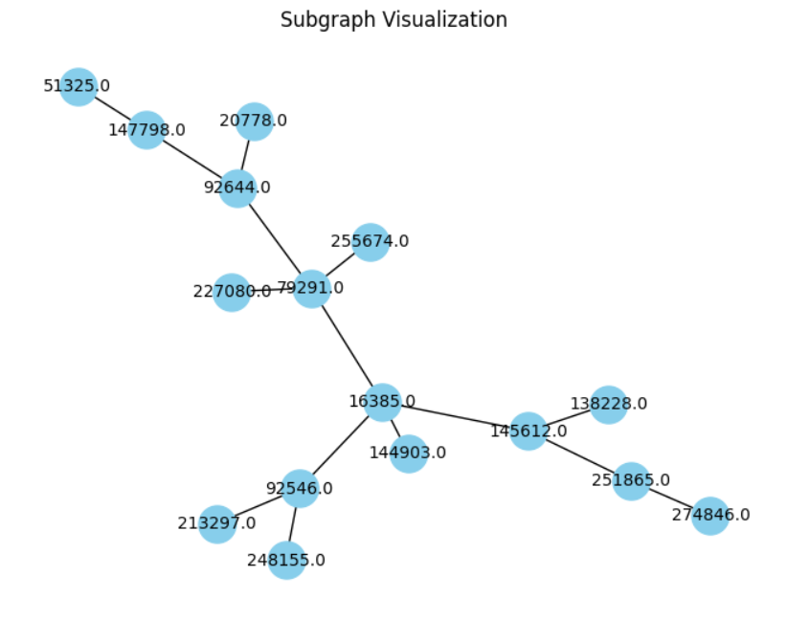
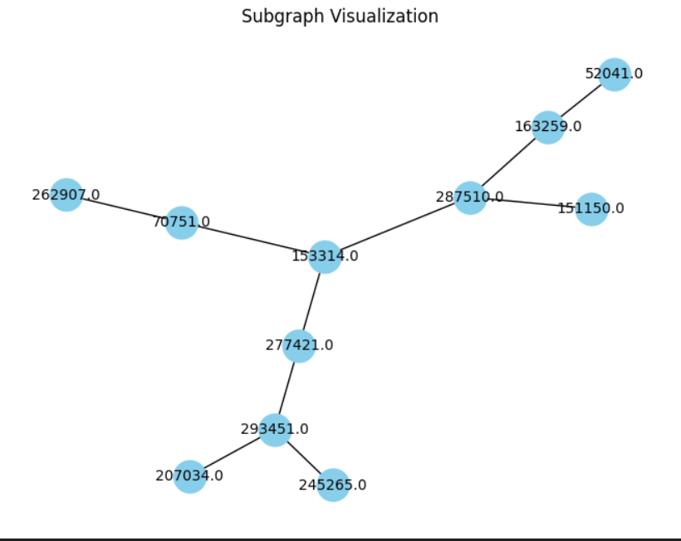
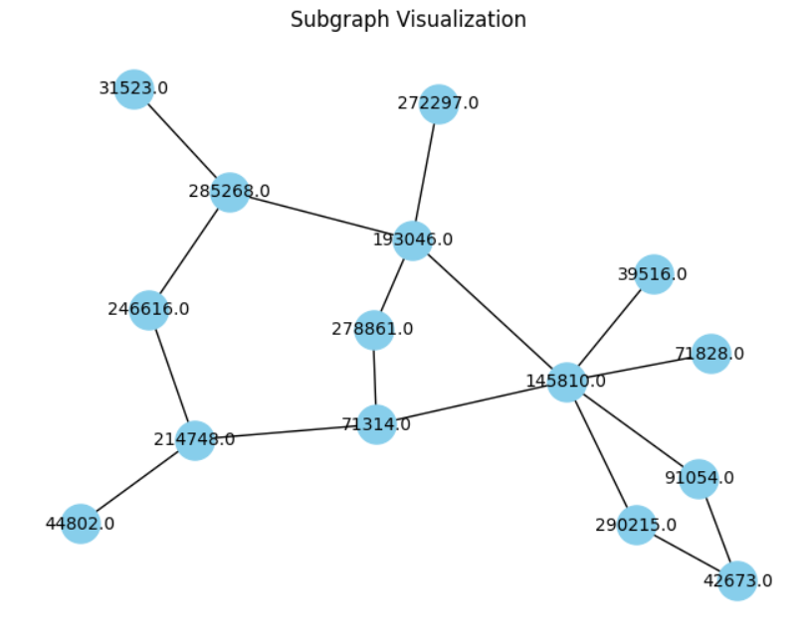
Community Detection: Graphical resutls

Slide 24
Community Detection: Spectral Clustering for diversity
'Based on their analysis of expert opinions, illegally traded wildlife has the most distinct and diverse attributes compared to the other illicit networks.' -- B.K. Keskin
From Quantitative Investigation of Wildlife Trafficking Supply Chains: A Review

Slide 25

Community Detection: Spectral Clustering for diversity with connectivity constraints
Approach
Use Louvain modularity maximization to make multi-scale partitions
Use spectral clustering with an attribute dissimilarity matrix
Compute pairwise attribute dissimilarity
Transform into similarity matrix
Get resulting clusters and ensure connectivity
Go through each cluster and post-processes to ensure connectivity
Keep connected components as clusters
Resulting Partitions
10 regional/global modules
~ 550 clusters
Use GNN to predict on nodes: 50 predicted main actors

Slide 26
Community Detection: Spectral Clustering for diversity with connectivity constraints
Results
Filtered on word score
Filtered on wire amount
Countries | Max Wire | Max Msg Score | # domestic trxs | # foreign outbound trxs | # foreign inbound trxs | # unknown trxs | Ages | Tenures
CA, US | ~14k | 0.56 | 0 | 0 | 2 | 3 | 33, 29, 46, 40 | 8, 6, 15, 9
IN, US, CA | ~2k | 0 | 1 | 0 | 1 | 2 | 35, 43, 48, 59 | 14, 4, 5, 14

Slide 27
Task 3

Slide 28
Task 3: RETRIEVAL-AUGMENTED GENERATION (RAG) AND LLM
Objective: To find known wildlife traffickers from the web as far back as 2012
Methodology (Final)
Combine the use of LLM-based agent (deprecated) and RAG
Web scraping relevant news domain
justice.gov/news
Toronto Star
CTV news
Text split and load metadata to vector store
Use LangChain framework to develop a Corrective Retrieval Augmented Generation (CRAG)

Slide 29
Deprecated approach-LLM agent
Give LLM a set of tool and prompt engineer the model to find the answer
Pros:
Accessible to different tools
Logical reasoning and divide a complex problem into simpler sub-problem to solve
Cons:
The output is not stable
hard to do prompt engineering

Slide 30
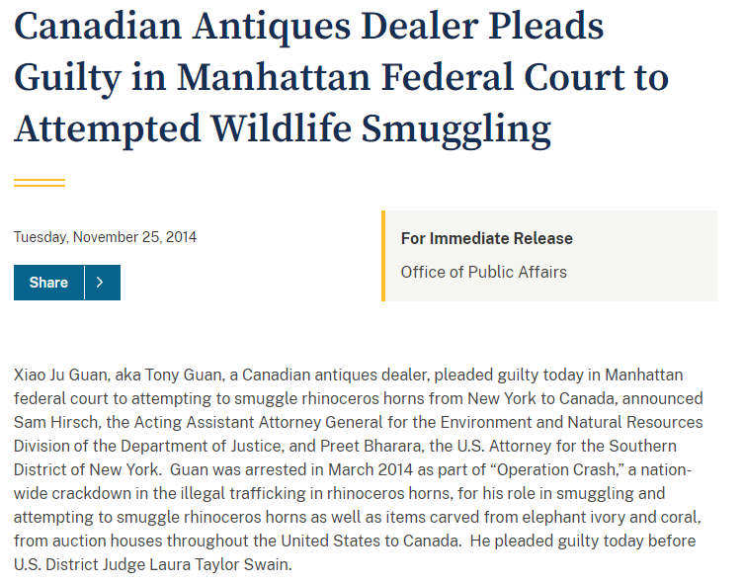
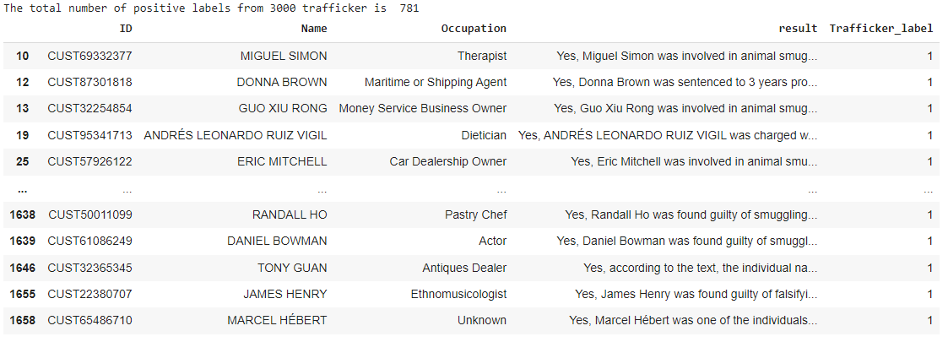
Simple Retrieval-Augmented Generation (RAG) and LLM
Tool :
Web Scraping: Use Scrapy lib in python to scrape the http://www.justice.gov/news/
Keyword Search (from the website) : "Animal Poaching"; "Animal Smuggling"; "Animal Trafficking; Smuggling"; "Trafficking"
LLM Model: Llama2 from huggingface Hub: "meta-llama/Llama-2-13b-chat-hf"
Pinecone vectorstore (50k record): Embedding the text chunk:"sentence-transformers/all-MiniLM-L12-v1"
LangChain RetrievalQA pipeline

Slide 31
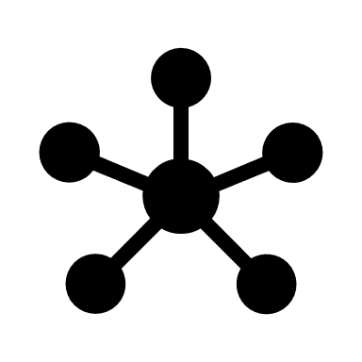

LLM MODEL with rag
" Is someone an animal trafficker? "
News articles
Pinecone Vector store
Embedding Model
Retrieval Augmented Generation (RAG)
Llama 2 Model

Slide 32
FINAL Method Corrective Retrieval Augmented Generation (CRAG)
Mistral Model
No
Answer!
Grading
Any Irrelevant?
" Query "
Yes
Transform Query
Web search
Corrective Retrieval Augmented Generation (CRAG) Flow Diagram
Source: Corrective Retrieval Augmented Generation Shi-Qi et.al.

Slide 33
CRAG Pseudocode
1. Query the LLM to retrieve information from the Vectorstore.
2. Grading Prompt:
a. Instruct the LLM agent to grade the relevance of the top 5 documents obtained through similarity search to the given question or query.
b. If all 5 documents are deemed relevant:
- The agent will formulate a decision based on the information extracted from these documents.
c. If any one of the documents is deemed irrelevant:
- Instruct the agent to utilize the DuckDuckGo search tool to obtain more pertinent results.
- Evaluate the new set of documents retrieved from the search tool.
- Formulate a decision based on the combined information extracted from both the original documents and the additional search results.

Slide 34
Task 3-Result
Increase the accuracy and reduce LLM hallucination
how to detect and correct the wrong knowledge more accurately and effectively still requires further study. [Shi-Qi 2024]
Name | Gender | Occupation | Age | Tenure | cust_id | Response | website
TONY GUAN | male | Antiques Dealer | 48 | 10 | CUST32365345 | YES | https://www.justice.gov/opa/pr/canadian-antiques-dealer-sentenced-30-months-prison-smuggling-rhinoceros-horns-elephant-ivory
GREGORY LOGAN | male | Unemployed | 65 | 8 | CUST14701697 | YES | https://www.justice.gov/opa/pr/canadian-man-detained-money-laundering-charges-stemming-conspiracy-smuggle-narwhal-tusks
RANDALL WEHRKAMP | male | Unknown | 67 | 6 | CUST72930228 | YES | https://globalnews.ca/news/6530671/gronlid-saskatchewan-illegal-wildlife-trafficking-randall-wehrkamp/
GRIGORI ZAHAROV | male | Other | 28 | 7 | CUST12136191 | YES | https://globalnews.ca/news/3515547/ontario-man-gets-3-months-in-jail-for-illegally-trafficking-wildlife/
DONG YAN | female |  | 44 | 4 | CUST62788134 | YES | https://www.ctvnews.ca/canada/ont-man-fined-for-smuggling-nearly-40-live-turtles-in-his-pants-1.2792723
KAI XU | male | Other | 34 | 10 | CUST30572335 | YES | https://www.ctvnews.ca/canada/ont-man-fined-for-smuggling-nearly-40-live-turtles-in-his-pants-1.2792723

Slide 35
COnclusion
Task 1
Achieved 0.8 F1 score for the MLP classifier with descent feature engineering
Task 2
Achieve desired result from a GCN network followed by community detection
Narrow down to a reasonable detection of positive trafficking label from 10,850 to 984.
Task 3
Built a RAG pipeline to identify person related to wildlife crime with limitation.
Future work:
More clean datasets for the embedding model and LLM model to learn
More precise prompt for the model to generate the answer we want:
i.e. "Animal Trafficking" and "Wild Trafficking" have different meaning and different results from the model.

Slide 36
Thank you

